Slide 1
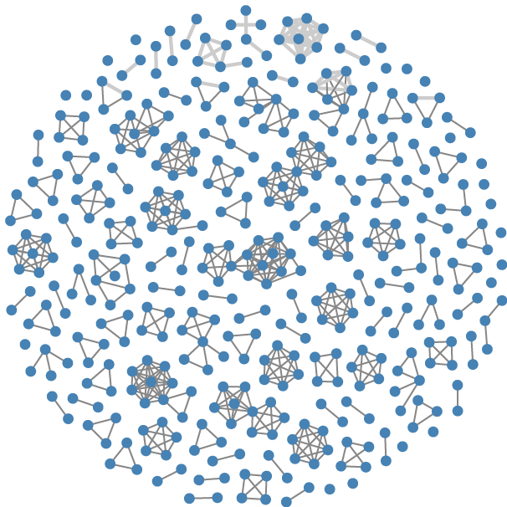


GraphLDA: Latent Dirichlet Allocation-based Visual Exploration of Dynamic Graphs
Lijing Lin, Siming Chen, Fan Hong, Chufan Lai, Shuai Chen, Xiaoru Yuan
School of EECS, Peking University

Slide 2


